Slide 1
Building a Maximum Likelihood Tree
Analysis Module

Slide 2
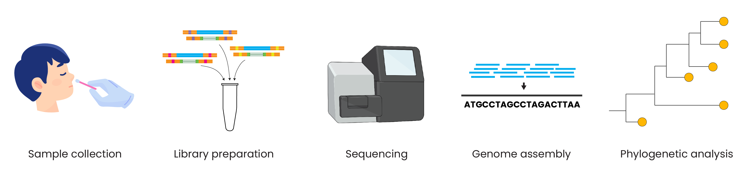
Genomic epidemiology workflow
BioRender.com
Pixel True https://www.pixeltrue.com/about, CC BY-SA 4.0, via Wikimedia Commons

Slide 3
Outline
Maximum likelihood
How to build trees with IQTREE
Input data
Model selection
Bootstrapping
Tree search algorithm

Slide 4
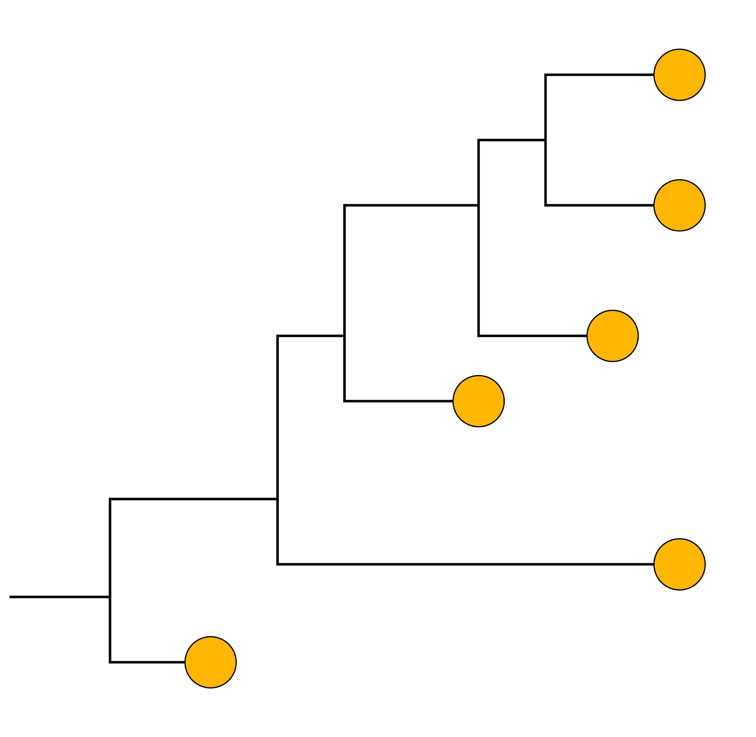
How do we build phylogenetic trees?
A
G
GTCTCGGCTC
GTGTCGGCTA
GTGTCAGCTA
GTGCCAGCTA
GGGCCATCTA
ATGCCAGCTA
C
T
Multiple sequence alignment
Substitution model
Phylogenetic tree
Bootstrapping

Slide 5
There are several methods of building trees
Distance-based neighbor-joining
Parsimony
Maximum likelihood
Bayesian

Slide 6
Building maximum likelihood trees
Maximum Likelihood (ML): a statistical framework that allows us to assess which hypothesis (tree) best explains our data (the sequences)
The degree to which the data or alignment supports a hypothesis or tree is termed the likelihood.
ML is a very statistically robust method to model sequence evolution and generate a single tree or phylogeny

Slide 7
Find the tree that makes the data most probable
Probability?
A
G
GTCTCGGCTC
GTGTCGGCTA
GTGTCAGCTA
GTGCCAGCTA
GGGCCATCTA
ATGCCAGCTA
+
C
T
Or would a different tree explain the sequence alignment better?

Slide 8
Software to infer phylogenies by maximum likelihood
IQ-TREE
RAxML
PhyML
Garli
FastTree
Pros and cons to each software
Several options have web servers for easy-to-use, online computation

Slide 9

IQ-TREE: web server: http://iqtree.cibiv.univie.ac.at/

Slide 10
Step 1: Input data
IQ-TREE: web server: http://iqtree.cibiv.univie.ac.at/

Slide 11
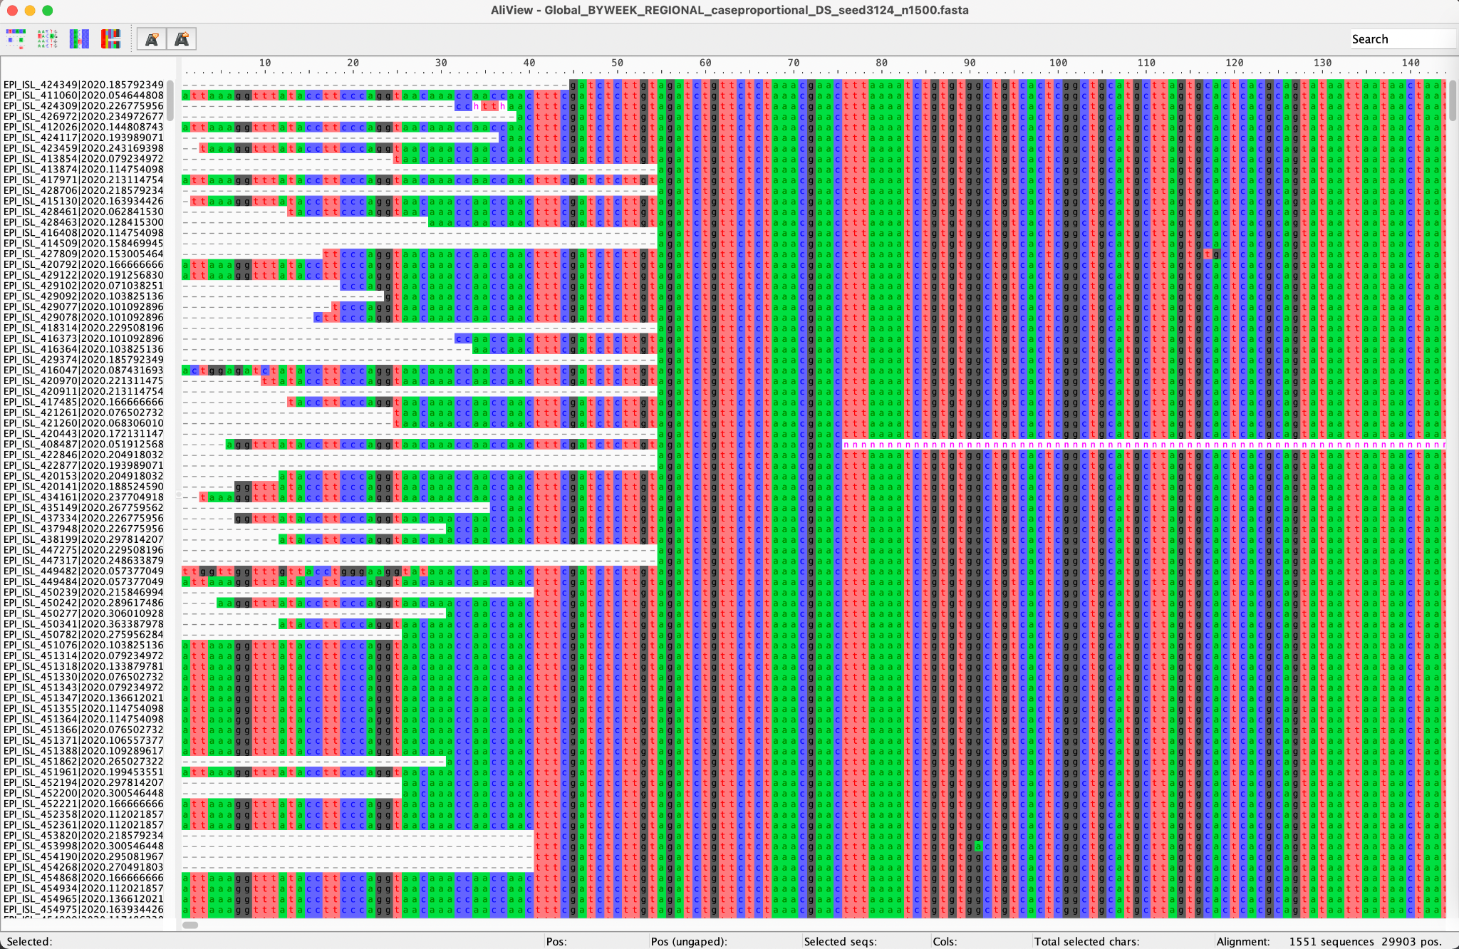
IQ-TREE input: multiple sequence alignment

Slide 12

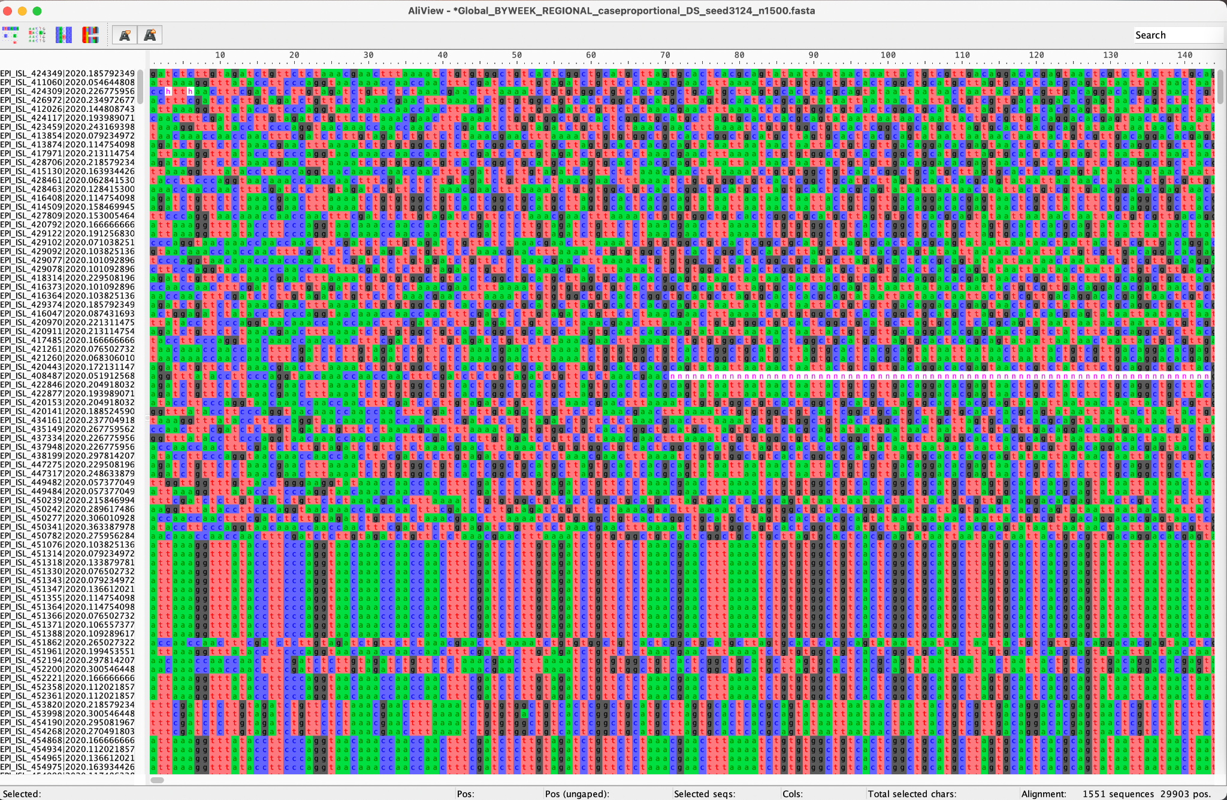
Sequences must be aligned
Don’t use unaligned sequences

Slide 13
Step 2: Substitution model selection
IQ-TREE: web server: http://iqtree.cibiv.univie.ac.at/

Slide 14
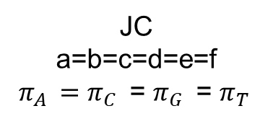
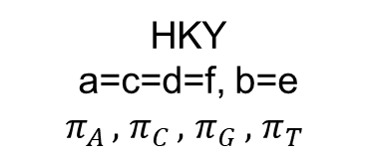
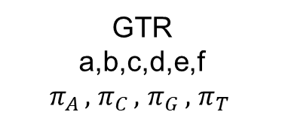
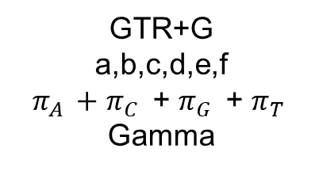
There are several options for substitution models
Substitution rate matrix
b
A
G
c
a
f
d
C
T
e

Slide 15
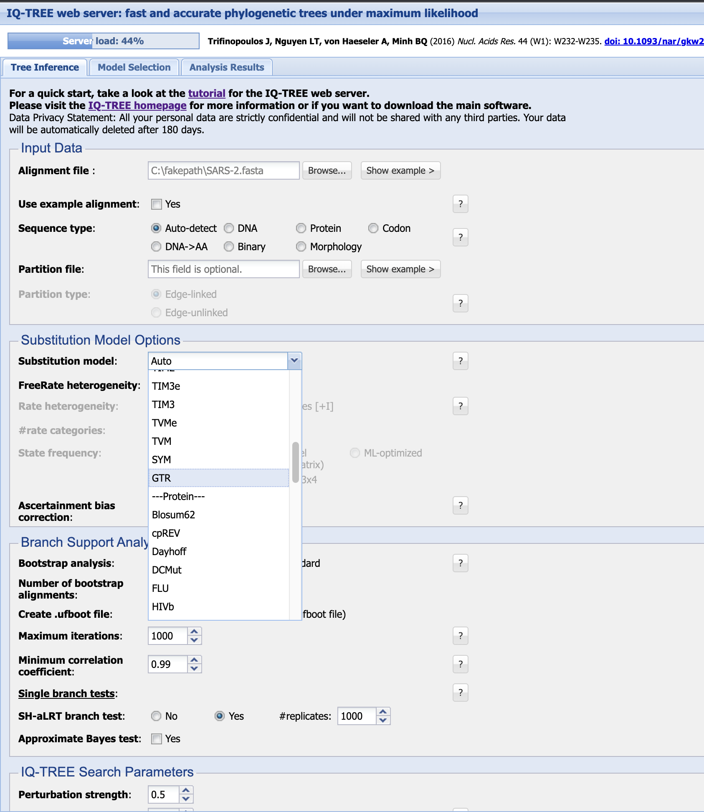
IQ-TREE: web server: http://iqtree.cibiv.univie.ac.at/

Slide 16

IQ-TREE: web server: http://iqtree.cibiv.univie.ac.at/

Slide 17
Allowing for rate heterogeneity
Substitution rate matrix
Different sites may evolve at different rates:
b
G | A | C | T | C | G | G | C | T | C
G | T | G | T | C | G | G | C | T | A
G | C | G | T | C | A | G | C | T | A
G | G | G | C | C | A | G | C | T | A
G | G | G | C | C | A | G | C | T | A
A | T | G | C | C | A | G | C | T | A
A
G
c
a
f
d
C
T
e

Slide 18
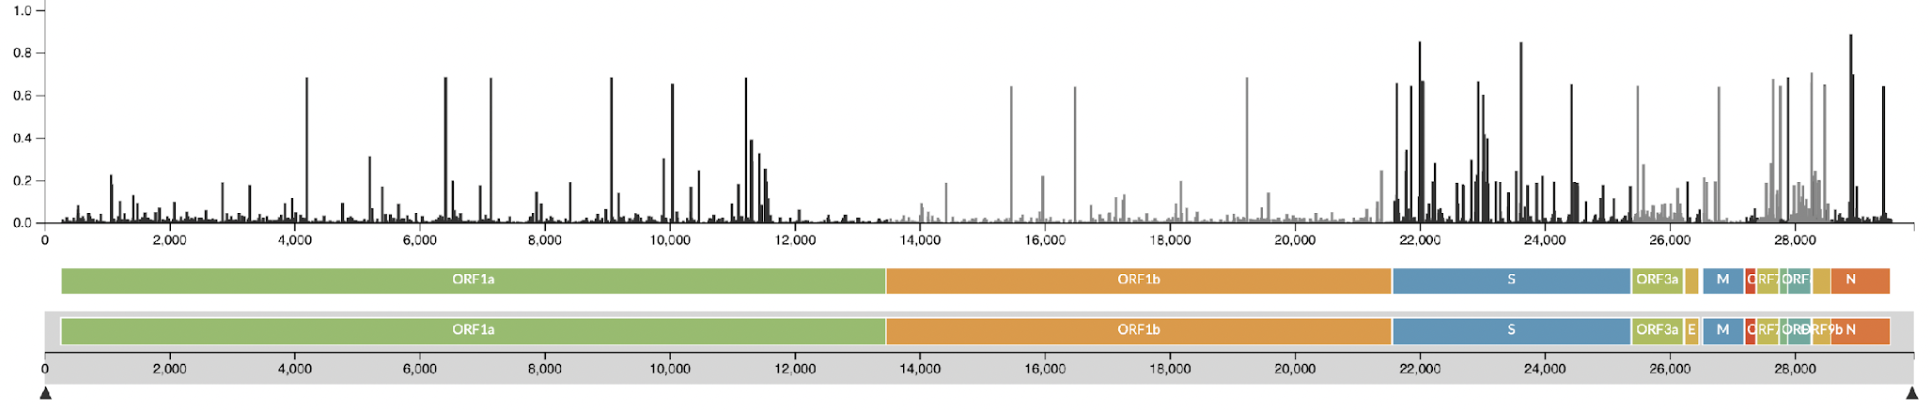
Allowing for rate heterogeneity
Different selection processes acts on different sites
Site 1 evolves fast
G | A | C | T | C | G | G | C | T | C
G | T | G | T | C | G | G | C | T | A
G | C | G | T | C | A | G | C | T | A
G | G | G | C | C | A | G | C | T | A
G | G | G | C | C | A | G | C | T | A
A | T | G | C | C | A | G | C | T | A
https://nextstrain.org/ncov/gisaid/global

Slide 19
Allowing for rate heterogeneity
Different selection processes acts on different sites
Site 5 evolves slowly
G | A | C | T | C | G | G | C | T | C
G | T | G | T | C | G | G | C | T | A
G | C | G | T | C | A | G | C | T | A
G | G | G | C | C | A | G | C | T | A
G | G | G | C | C | A | G | C | T | A
A | T | G | C | C | A | G | C | T | A
https://nextstrain.org/ncov/gisaid/global

Slide 20
IQ-TREE: web server: http://iqtree.cibiv.univie.ac.at/

Slide 21
Step 3:
Branch support (bootstrapping)
IQ-TREE: web server: http://iqtree.cibiv.univie.ac.at/

Slide 22
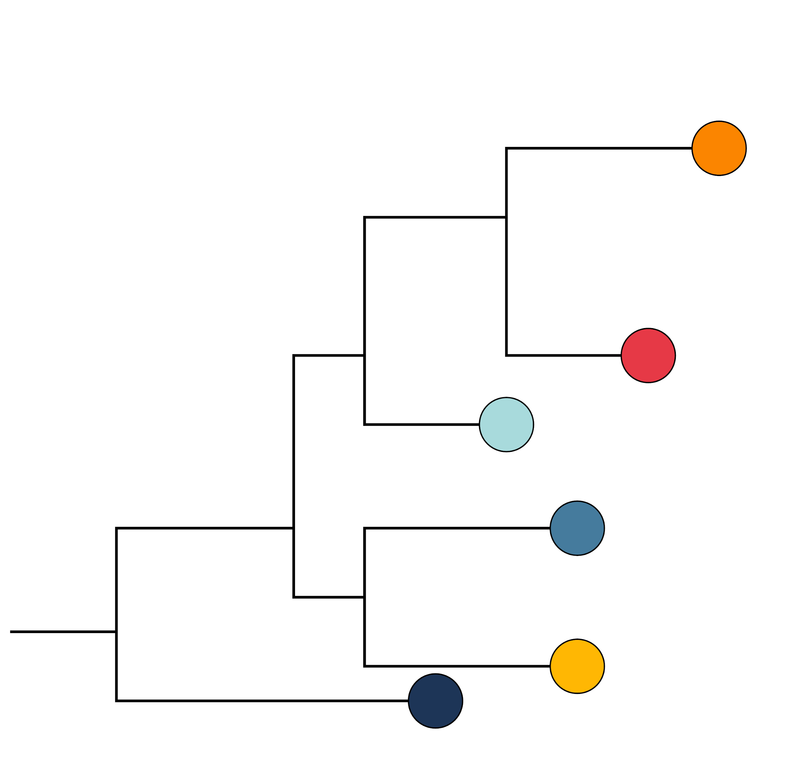
How much can we trust the tree?
Would we still get the same tree if the data was slightly different?
Tree based on original alignment
G | T | C | T | C | G | G | C | T | C
G | T | G | T | C | G | G | C | T | A
G | T | G | T | C | A | G | C | T | A
G | T | G | C | C | A | G | C | T | A
G | G | G | C | C | A | G | C | T | A
A | T | G | C | C | A | G | C | T | A

Slide 23
How much can we trust the tree?
Would we still get the same tree if the data was slightly different?
Tree based on original alignment
Resample alignment 1000 times
G | T | C | T | C | G | G | C | T | C
G | T | G | T | C | G | G | C | T | A
G | T | G | T | C | A | G | C | T | A
G | T | G | C | C | A | G | C | T | A
G | G | G | C | C | A | G | C | T | A
A | T | G | C | C | A | G | C | T | A
G | C | C | G | G | C | T
G | C | G | G | G | A | T
G | C | G | A | G | A | T
G | C | G | A | G | A | T
G | C | G | A | G | A | G
A | C | G | A | A | A | T
1000x

Slide 24
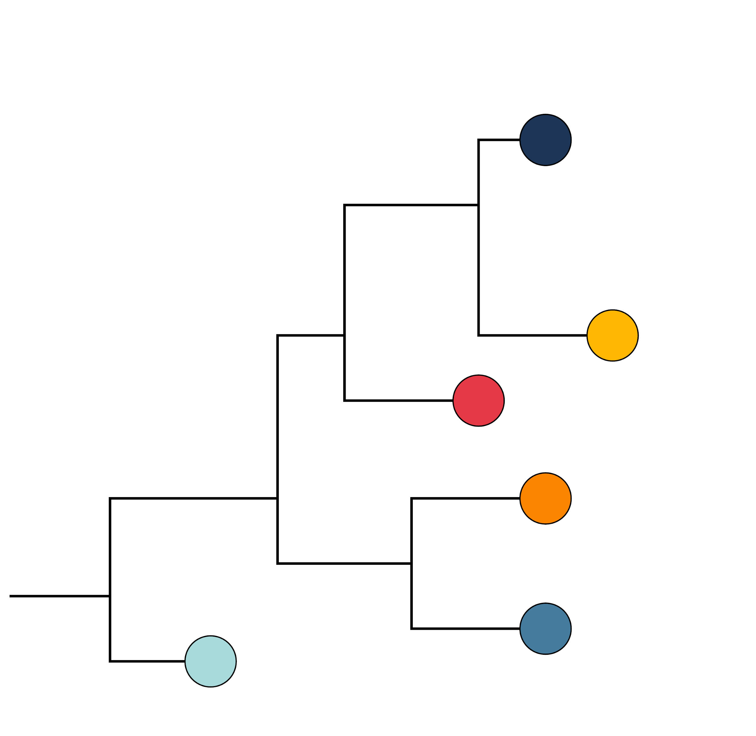
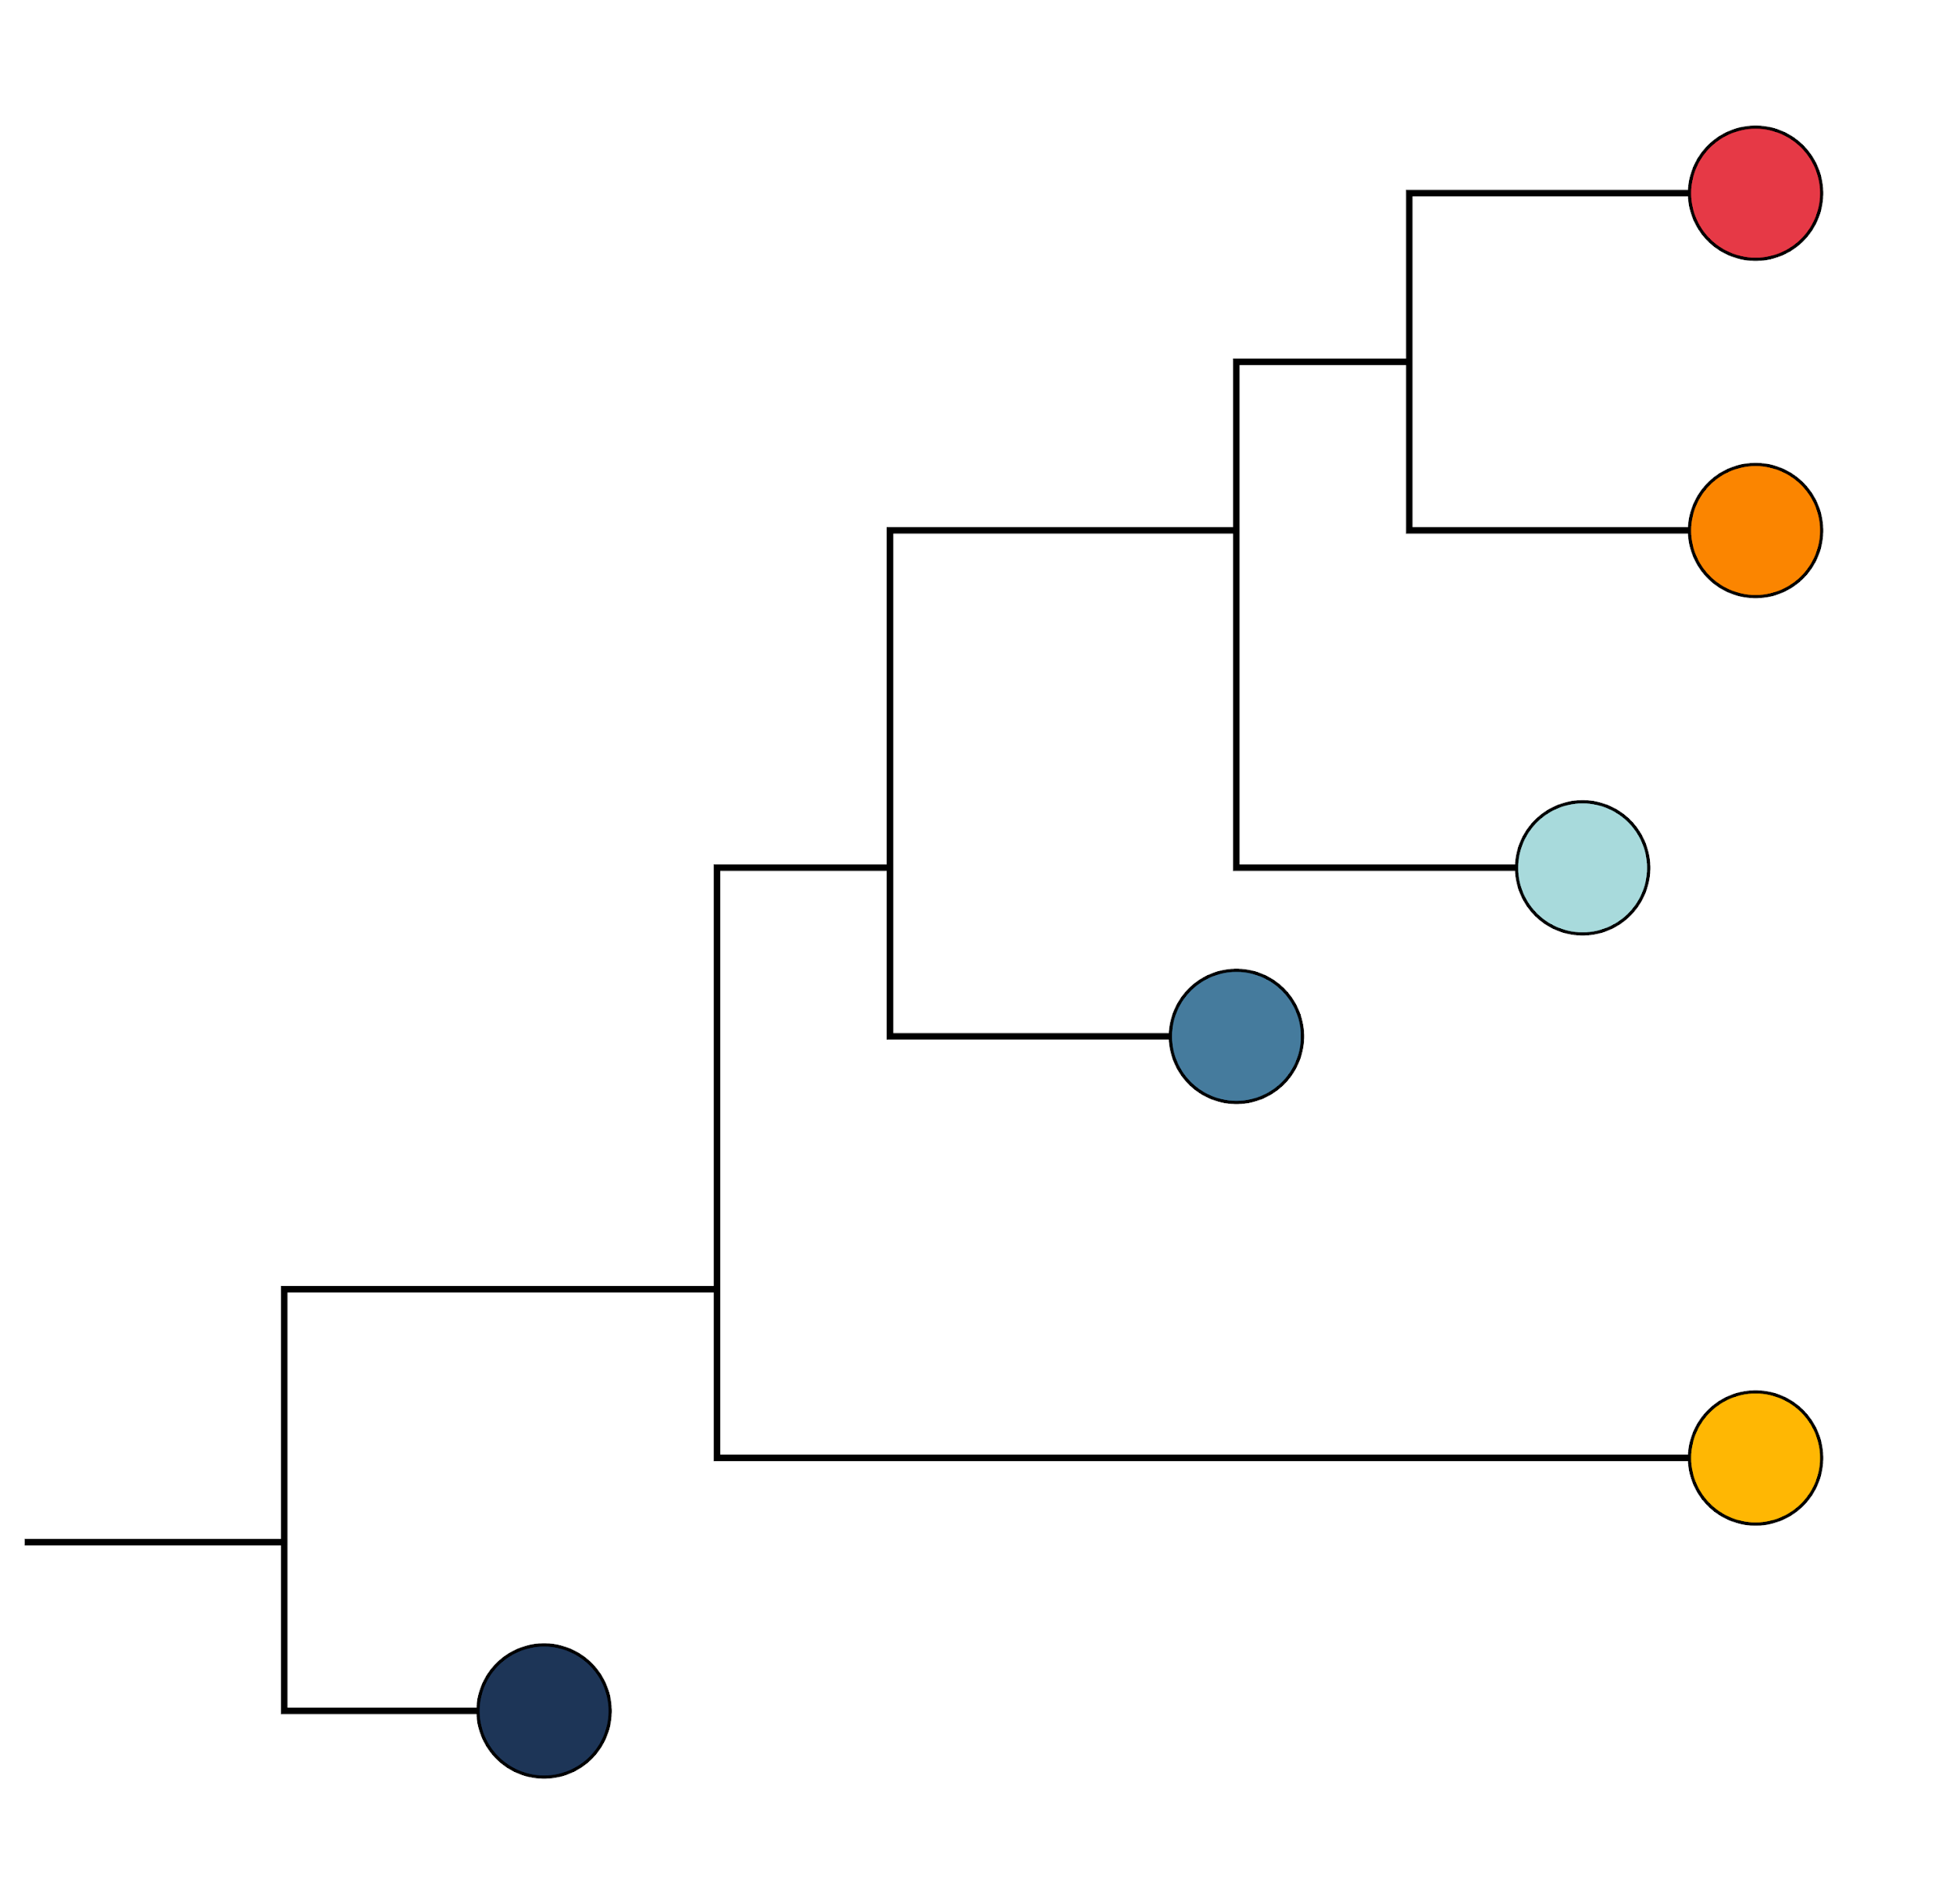
How much can we trust the tree?
Would we still get the same tree if the data was slightly different?
Tree based on original alignment
Resample alignment 1000 times
Build a tree for each resampled alignment
G | T | C | T | C | G | G | C | T | C
G | T | G | T | C | G | G | C | T | A
G | T | G | T | C | A | G | C | T | A
G | T | G | C | C | A | G | C | T | A
G | G | G | C | C | A | G | C | T | A
A | T | G | C | C | A | G | C | T | A
G | C | C | G | G | C | T
G | C | G | G | G | A | T
G | C | G | A | G | A | T
G | C | G | A | G | A | T
G | C | G | A | G | A | G
A | C | G | A | A | A | T
1000x
1000x
How many times do we see the same relationships?

Slide 25

Step 4:
Run IQ-TREE
IQ-TREE: web server: http://iqtree.cibiv.univie.ac.at/

Slide 26
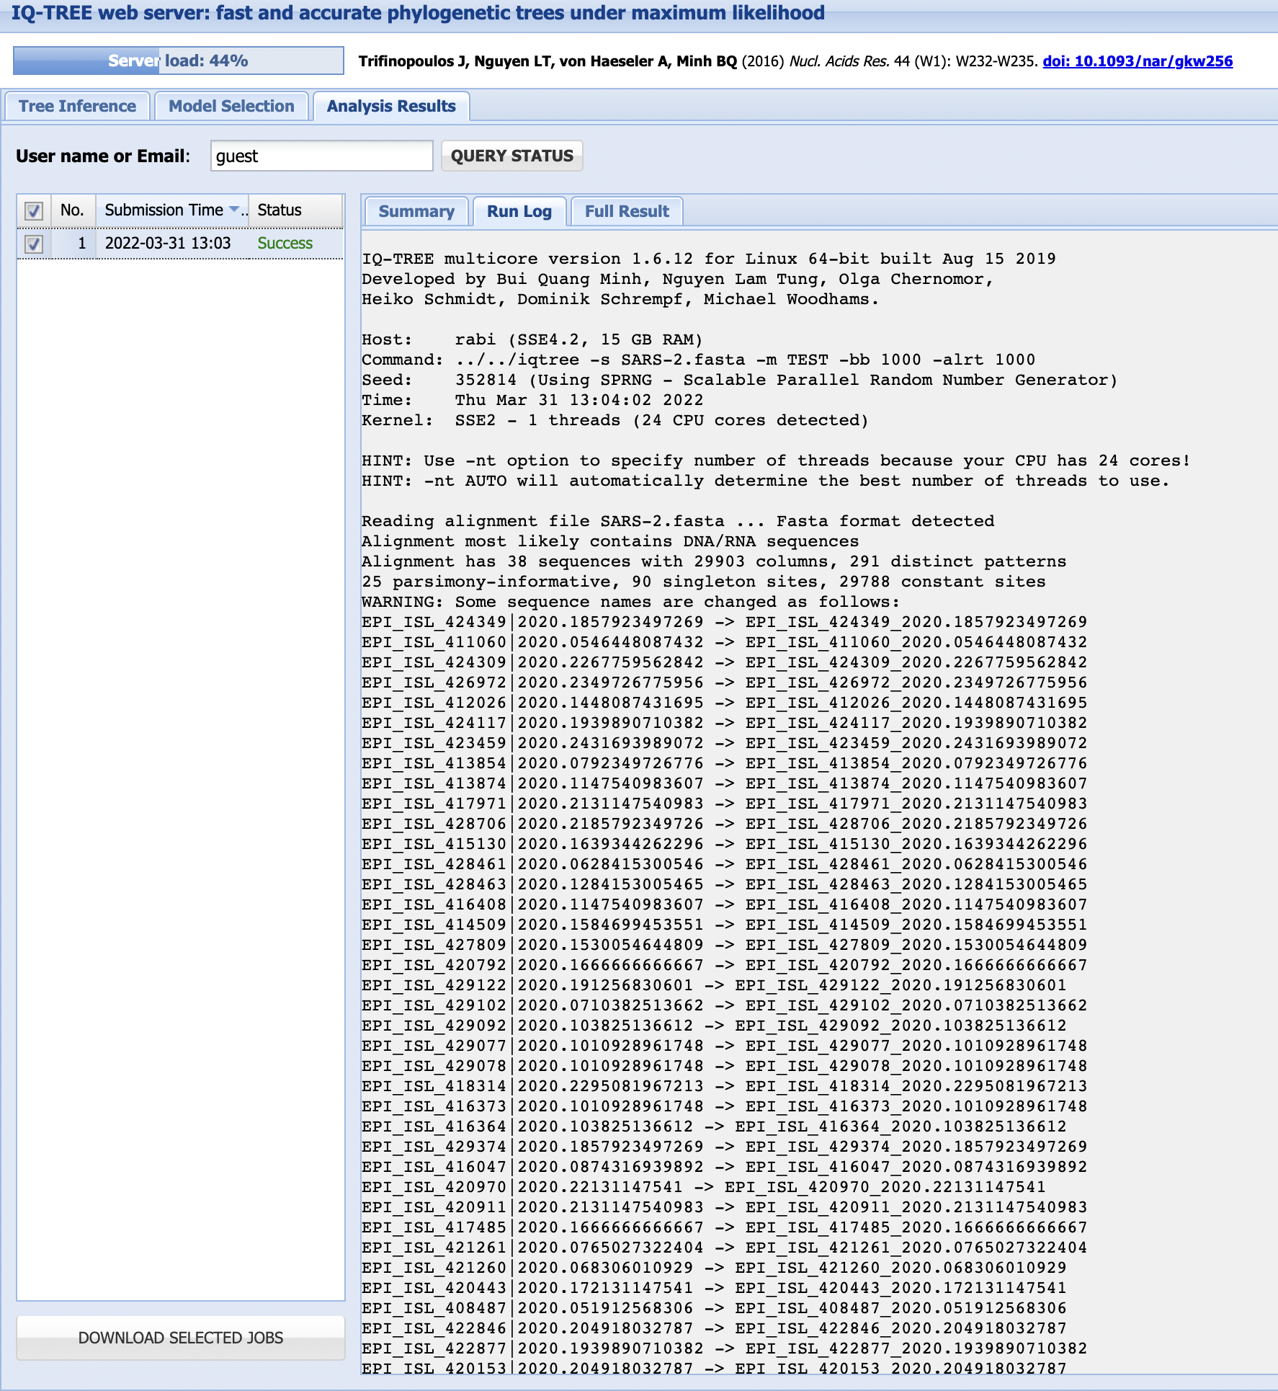

Slide 27
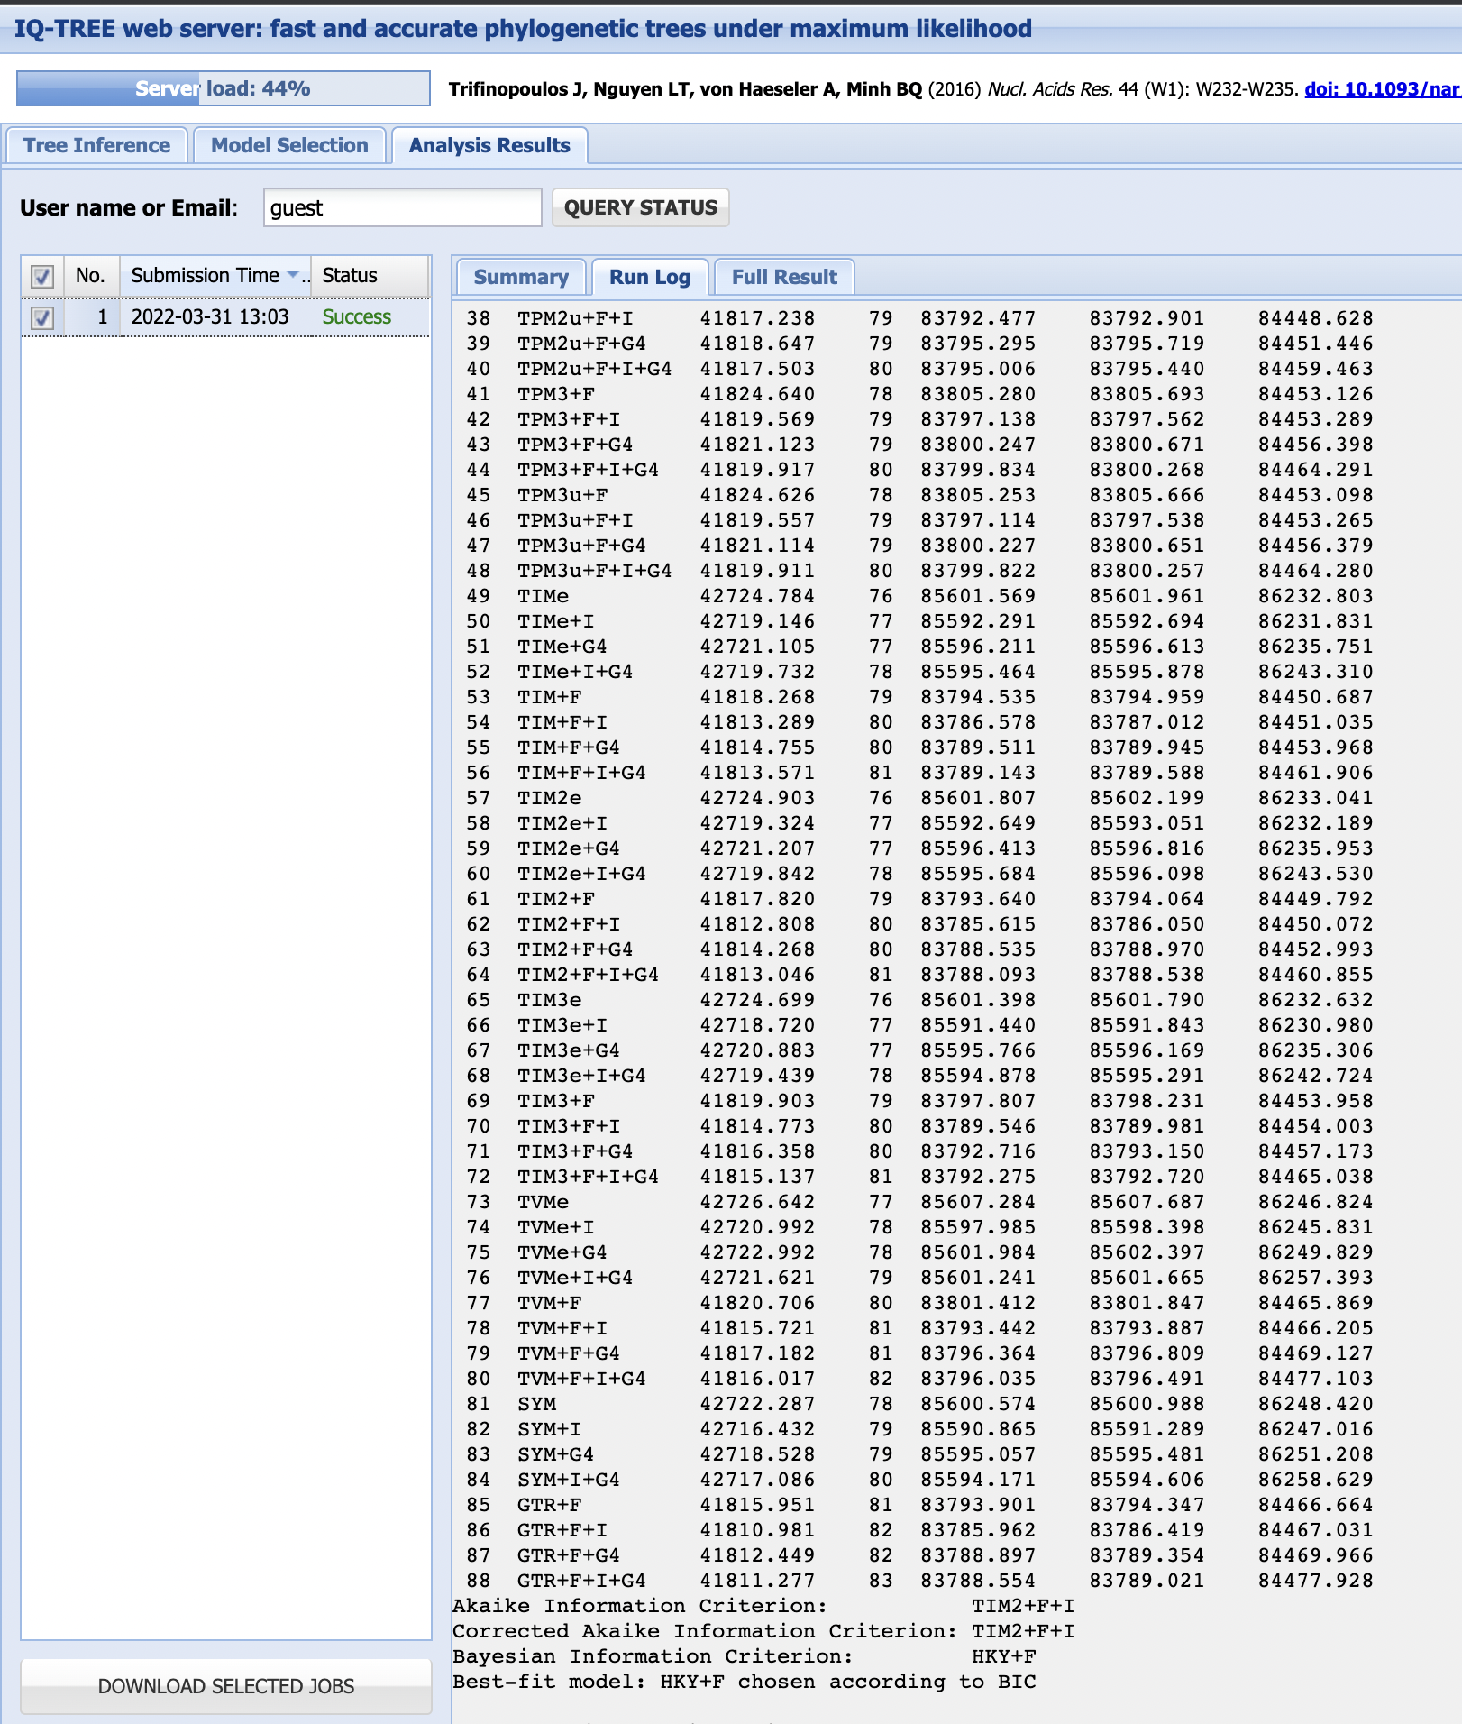
Testing different substitution models

Slide 28
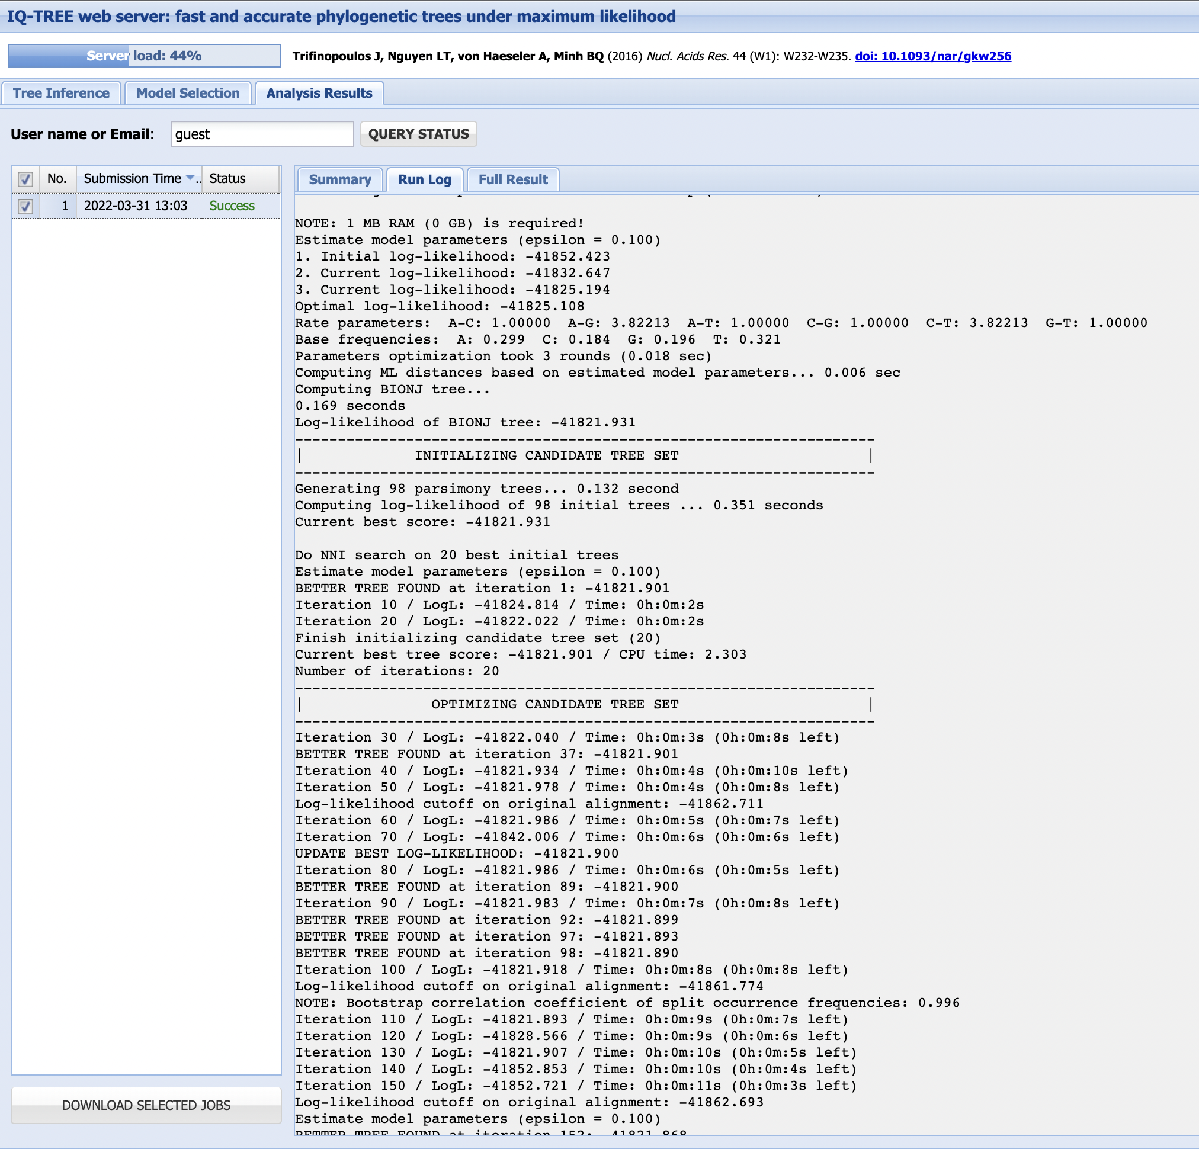
How does the maximum likelihood approach work?

Slide 29
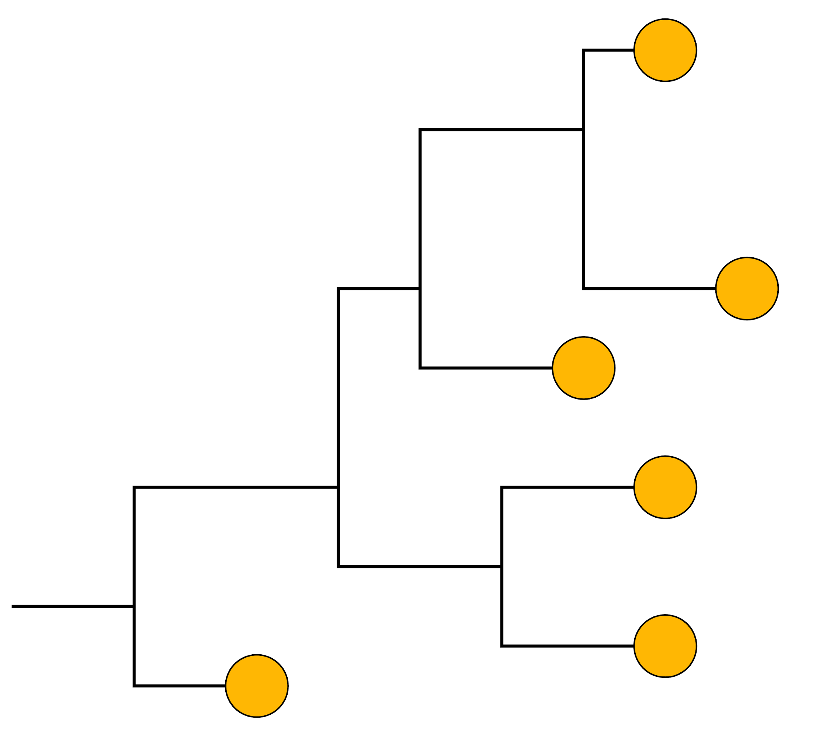
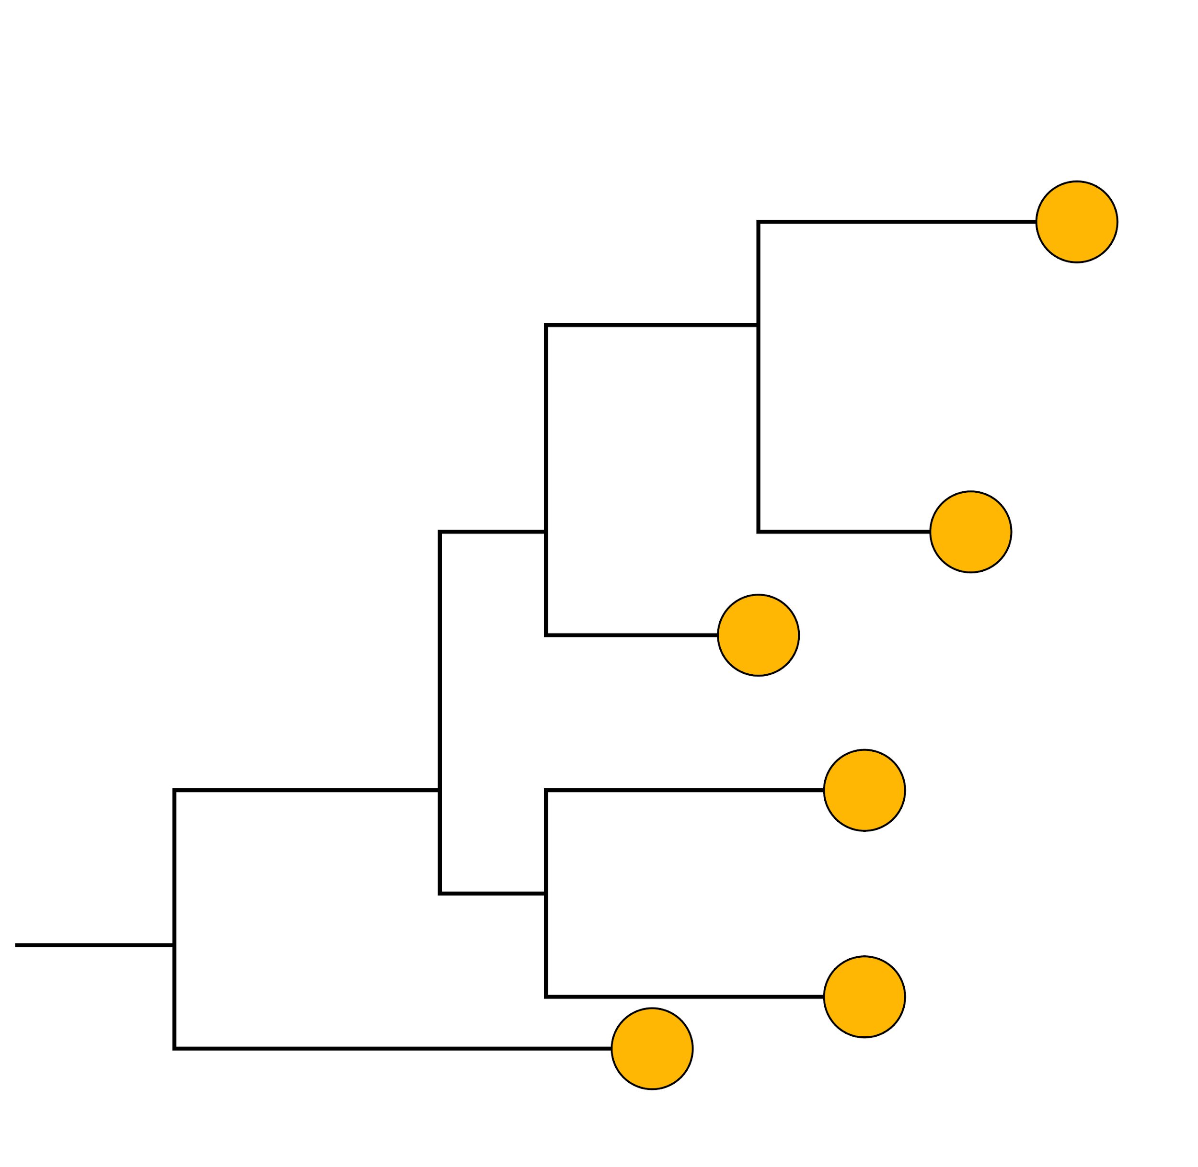

Tree search algorithm to find the best tree
lnL = -1111
lnL = -1344
lnL = -1561

Slide 30
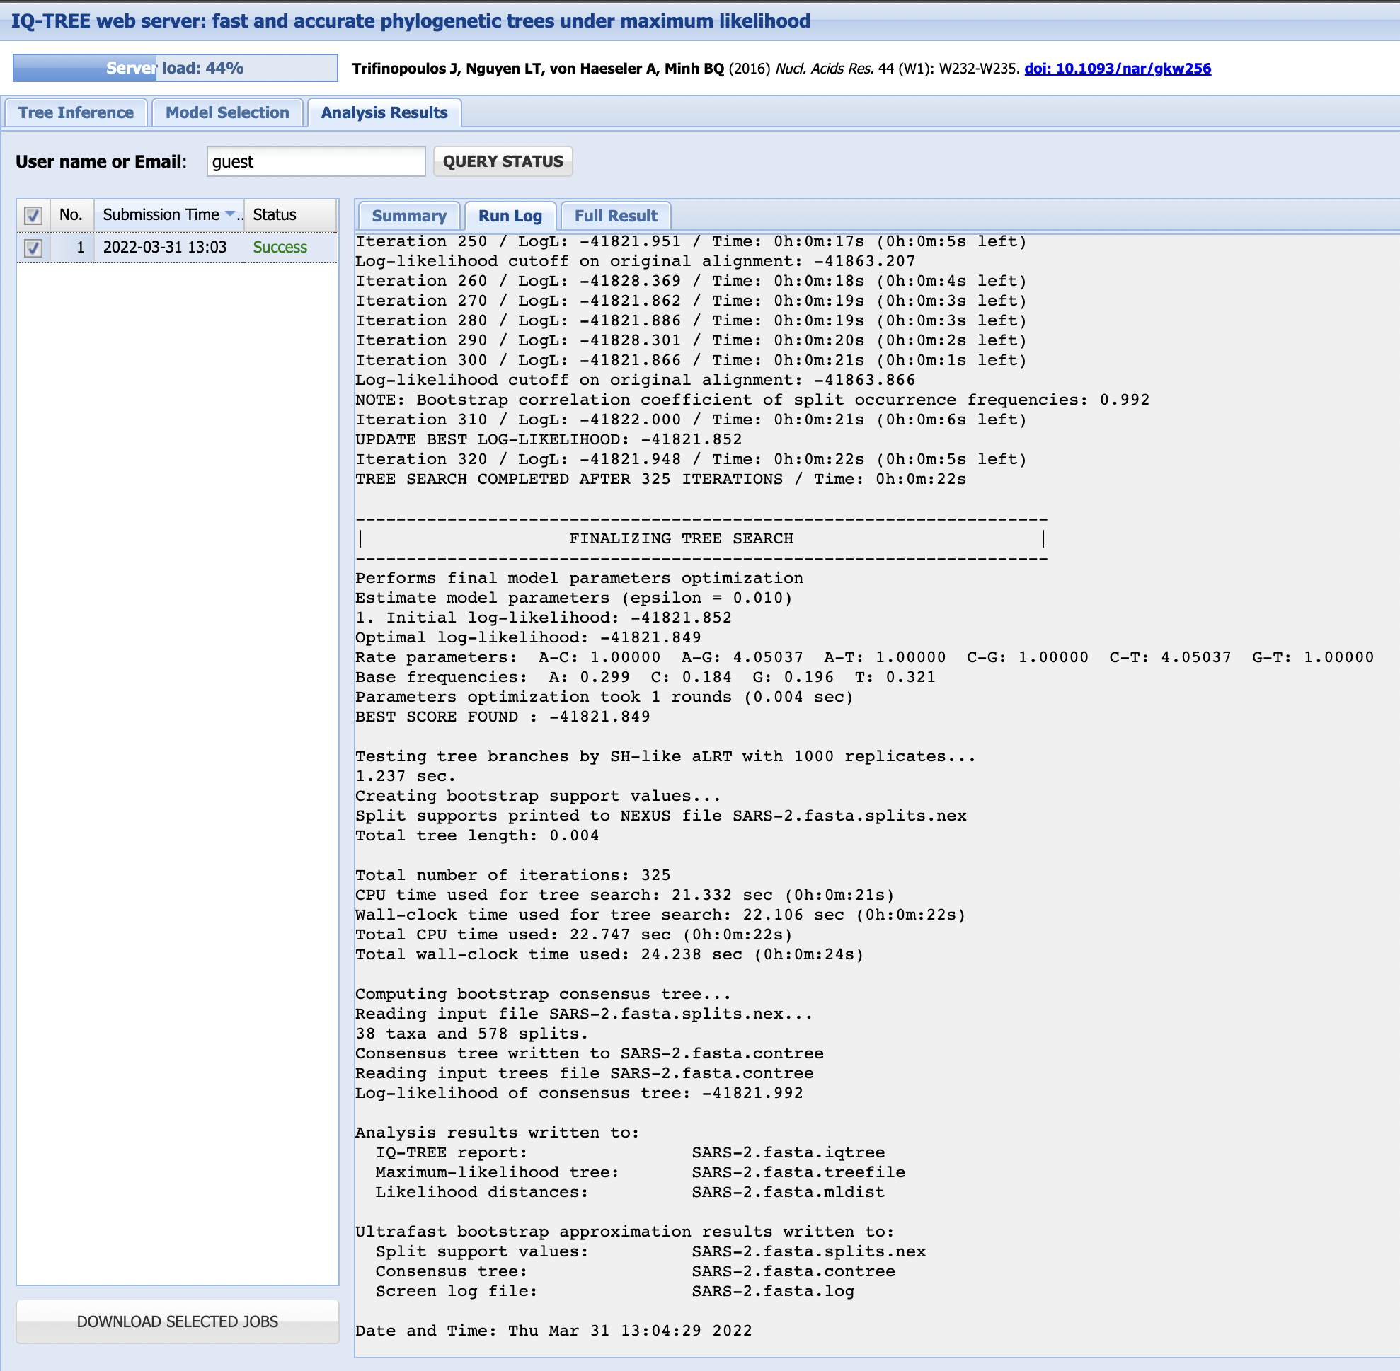

Slide 31
IQ-TREE output files
Suffix | Explanation
.iqtree | The main report file
.log | Logfile for the run
.treefile | Maximum likelihood tree in NEWICK format (can view in Figtree)
.svg | Tree visualisation in SVG format
.pdf | Tree visualisation in PDF format
.contree | Consensus tree with branch supports, with branch lengths optimized on the original alignment (if Ultrafast Bootstrap is used)
.ckp.gz | Checkpoint file

Slide 32
Summary
We can reconstruct phylogenies from multiple sequence alignments using maximum likelihood
IQ-TREE is one option for building maximum likelihood phylogenetic trees
We need to choose the correct substitution model for our dataset
Maximum likelihood methods only generate a single tree, so we need to test its repeatability with bootstrapping

